Slide 1
Two detector XRD pattern acquisition
Monty Cosby

Slide 2
Experimental setup
Detector crystal
Setup
2D area detector fixed at 15˚ 2θ below sample
Single crystal detector attached to goniometer
Acquisition:
Low-res pattern acquired by 2D area detector
Peaks identified in crude pattern
Move crystal detector to peak locations for data collection
Eliminates useless background acquisition
Diffracted
beam
Incident beam
2D area detector

Slide 3
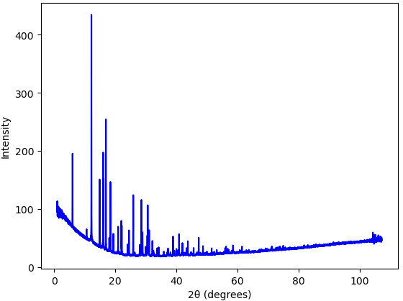
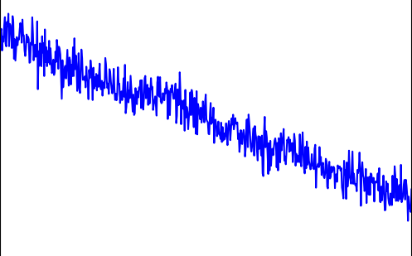
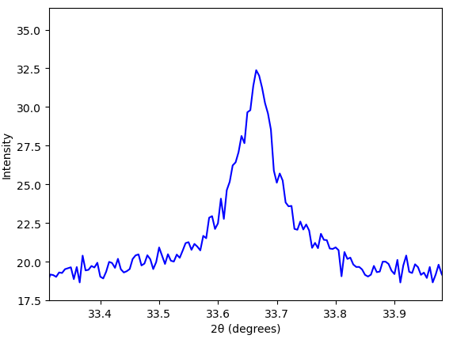

Peak picking from pattern
PbI₂ + ZnO
Peaks picked from integrated 2D pattern
SciPy peak pickers were poor
Difficult due to background (false peaks and not uniform)
Second derivative not always consistently negative
“false peaks”
Background issues
non-uniform
Derivative not always negative
Imperfect peaks

Slide 4
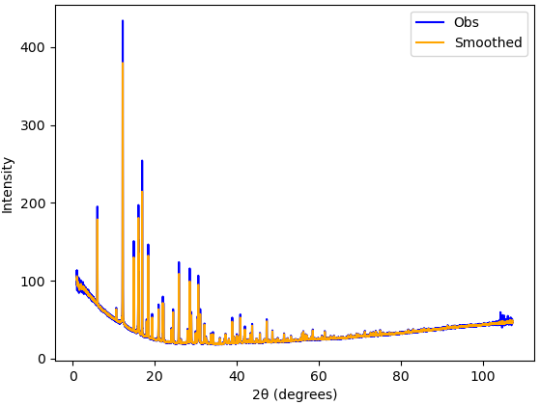
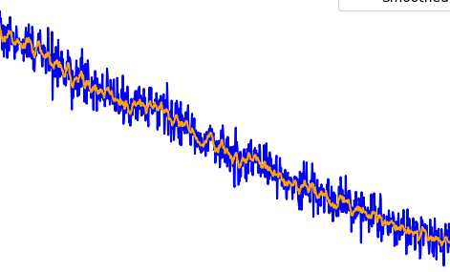
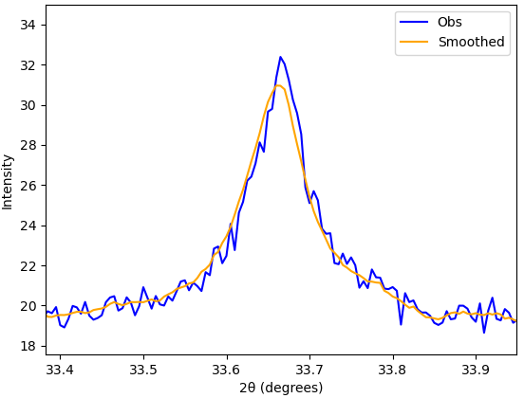

Peak picking from pattern
Peaks picked from integrated 2D pattern
SciPy peak pickers were poor
Difficult due to background (false peaks and not uniform)
Second derivative not always consistently negative
Current fix:
Smooth out pattern
Future fix:
Remove background with blank
Smooth out pattern
less random,
discriminable
Background issues
original
Imperfect peaks
smoothed

Slide 5
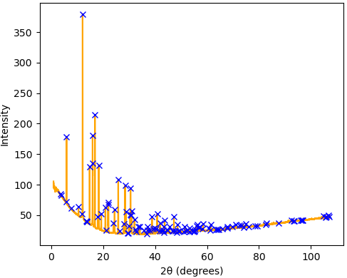
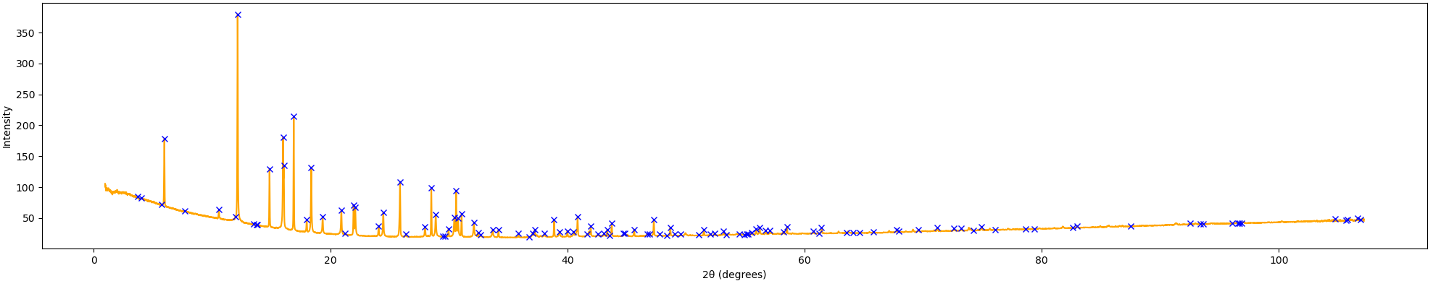
Peaks picked by python script
Code runs in ~1 s
Will improve after removing unnecessary visualization
Worsen with added integration
Hit/miss at high 2θ
Only a few mis picked peaks, one peak not picked by code
Will be easier to discriminate for smaller data region
PbI₂ + ZnO
February 2022
Circled are false positives for less than 40˚

Slide 6
The detector distance problem
Will need to convert 2θ from 2D area detector to crystal
Preliminary experiment should be run to determine the appropriate 2D area detector distance
Can use current setup by moving the detector to 15˚ and sliding closer to the sample to compare the patterns
Will give a good indication of ability to peak pick/smooth and if background subtraction is possible
Detector crystal
Peaks vs noise
2D area detector

Slide 7
The detector to distance problem
Will need to convert 2θ from 2D area detector to crystal
Preliminary experiment should be run to determine the appropriate 2D area detector distance
Can use current setup by moving the detector to 15˚ and sliding closer to the sample to compare the patterns
Will give a good indication of ability to peak pick/smooth and if background subtraction is possible
Detector crystal
Peaks vs noise
2D area detector
If efficient (and can move the detector distance from the bottom) ex situ measurements can be easily taken during the time
Low temperature melting or crystallization can be followed easily

